Slide 1
B cells and antibodies Antibody recognition of pathogens Why are antibodies specific and versatile
Pavel Tolar Institute of Immunity and Transplantation
Notes:
intro

Slide 2
B cells and antibodies
Intro ✔
B cell development ✔
B cell activation ✔
Germinal centre ✔
Antibody recognition of pathogens
Antibody effector function and memory

Slide 3
Learning objectives
What determines antibody specificity and affinity for pathogens?

Slide 4
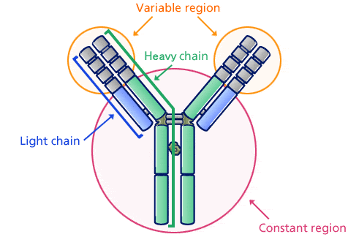
Different genes encode different functional parts of antibody
VDJ makes up Variable region antigen binding site
a.k.a paratope
Constant region downstream actions
FAB
FC

Slide 5
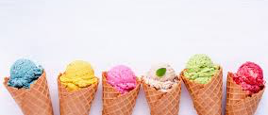
Antibodies as ice cream… Scoop = antigen binding variable region/FAB Cone = constant

Slide 6
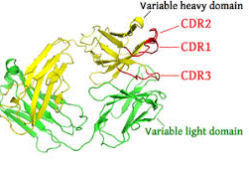
How does an antibody bind its target?
Combined heavy and light chain variable region form the binding site
Relative importance CDRH3 > 2 > 1 loops
Light chains also have CDRs – 3 > 2 > 1
Bind through hydrophobic bonding, van der Waals forces, and salt bridges

Slide 7
Antibodies bind by having diverse Fab/VDJs on a common framework
CDR: Complementarity determining region FR: Framework region

Slide 8
Question
How diverse can antibodies be based on this multi-component assembly?

Slide 9
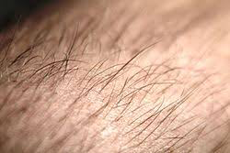


Hairs on body
5 million
People on the tube annually
1000 million
Stars in our galaxy
1,000,000 million
10^{^12}

Slide 10
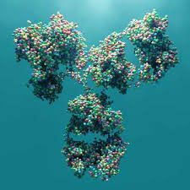
Hairs on body
5 million
X
People on the tube annually
1000 million
Stars in our galaxy
1,000,000 million
X
√

Slide 11
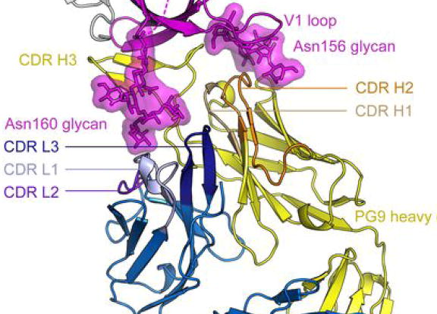
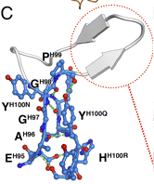
Real data: How does an antibody use its paratope to hit its target epitope?
Case study: PG9 vs HIV “Hammerhead”
Protrusion of CDR H3 due to Gly H97-Gly H98 , sandwiched between Tyr H100N and Tyr H100Q to form a stalk
Learn more: Pechjal et al. PNAS 2010 107 (25) 11483-11488
Learn more: McLellan et al. Nature. 2011 Nov 23;480(7377):336-43.

Slide 12
Somatic hypermutation enables affinity maturation of B cell clonal families
Point mutations are introduced into VDJ by activation induced cytidine deaminase (AID or AIDCA)
Changing aa can ⬆ binding of BCR to antigen
Results in ⬆ signalling ➔ B cell survives
If ⬇ binding of BCR, ⬇signalling ➔B cell apoptosis
Affinity maturation

Slide 13
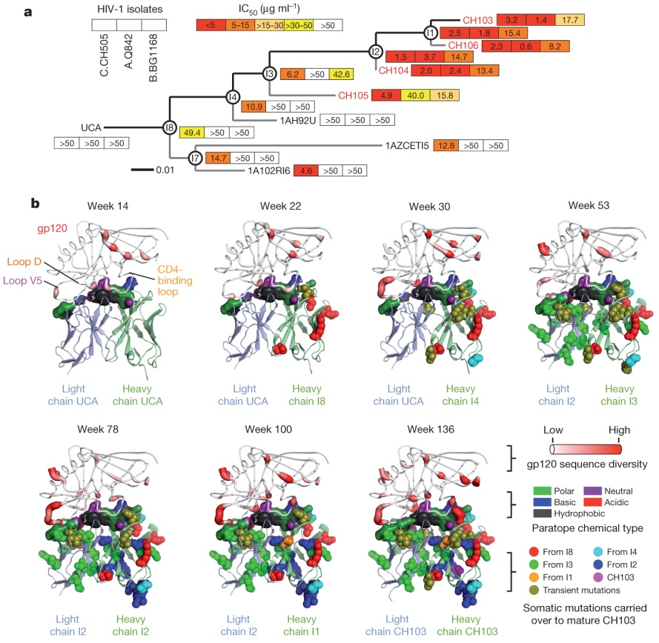
Real Data: Affinity increase during HIV infection ➔ anti-viral activity
Affinity maturation allows B cells to specialise – makes memory worth it
Learn more affinity:
H-X Liao et al. Nature 000, 1-8 (2013)

Slide 14
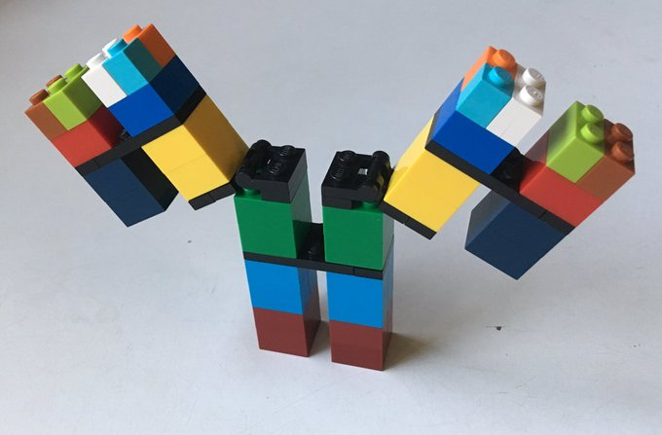
Summary: Antibody recognition of pathogens
Antibodies made from two proteins: heavy and light chain (kappa or lambda)
Fab or Variable region for binding specificity
Variable region made from V(D)J gene combinations
Binding antigen (epitope) by CDR1-3 of both heavy and light chains
Huge variability limits pathogen escape
Somatic mutations fine-tune CDRs for high affinity
Fc or constant region for conserved effector functions (coming up next)

Slide 15
Learning objectives
Intro: ✔ Describe the structural components that make up an antibody molecule and the function of each part
B cell development: ✔ Explain the role of B cell development in generation of the antibody repertoire and describe the underlying molecular mechanisms
B cell activation: ✔ Describe the signals that drive clonal B cell responses and differentiation into antibody-secreting cells
Germinal centre: ✔ Explain what germinal centres are and how they improve antibody affinity
Antibody recognition of pathogens: ✔ Explain why multi-component assembly is a critical factor in producing effective antibodies
6. Antibody effector function and memory: Explain how antibody responses protect from pathogens

